Slide 1
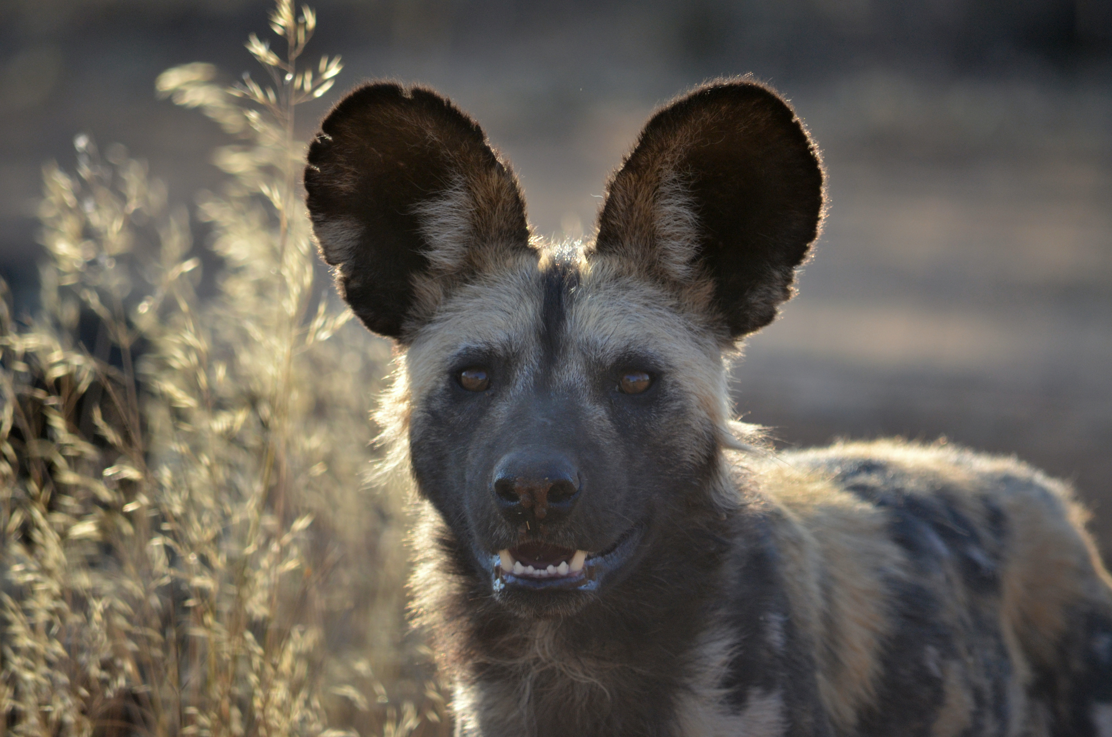





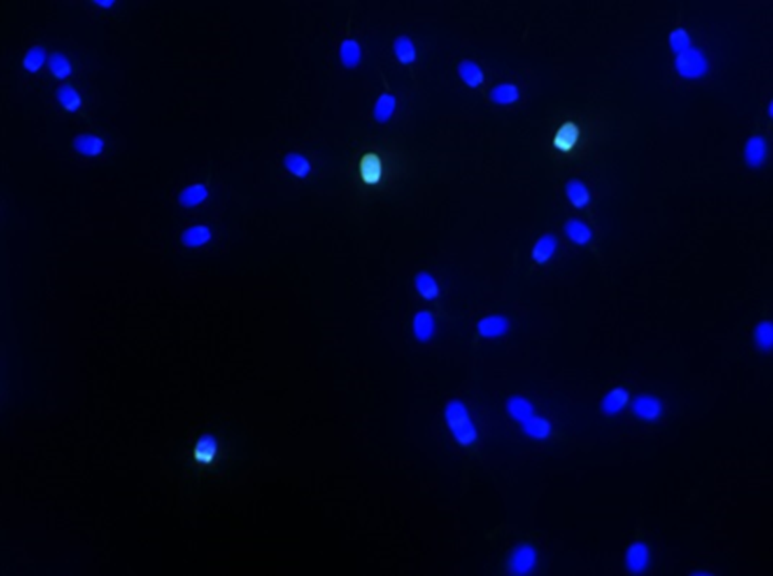
Successful cryopreservation of African wild dog (Lycaon pictus) spermatozoa: Towards developing the frozen zoo.
F. Van den Berghe^{1,2}, M.C.J. Paris^{1,2,3}, Z. Sarnyai¹, M.B. Briggs⁴, W.K. Farstad⁵ and D.B.B.P. Paris¹
¹College of Public Health, Medical and Veterinary Sciences, James Cook University, Townsville, QLD, Australia
²Institute for Breeding Rare and Endangered African Mammals, Edinburgh, UK
³Wageningen Livestock Research, Wageningen, The Netherlands
⁴African Predator Conservation Research Organization, Las Vegas, Nevada, USA
⁵Department of Production Animal Clinical Sciences, Norwegian University of Life Sciences, Oslo, Norway
Introduction
Development of assisted breeding techniques can aid conservation & management of the endangered African wild dog (Lycaon pictus). Previous attempts to freeze sperm from this species have proven unsuccessful with sperm motility dropping to nearly 0% within 2 h of thawing. The aim of this study was to improve the freezing success of African wild dog sperm by testing two routinely used canine cryopreservation protocols.
Results
Methods
(1) Sperm collected n=4 African wild dogs
Figure 2. Fresh and immediate post-thaw sperm quality when African wild dog semen is frozen using Protocol 1 and 2 (n = 4). Different letters within each parameter indicate a significant difference between treatments.
volume, colour, pH
motility, viability, morphology
sperm number
acrosome status, DNA integrity
Sperm motility decreased for both protocols immediately after thawing (Fig. 2), but remained higher for Protocol 2 between 2 – 6 h after thawing, and persisted up to 8 h (Fig. 3a).
Viability decreased for both protocols after thawing (Fig. 2), however remained 2 to 3.5-fold higher for protocol 2 throughout the post-thaw evaluation period (Fig. 3b).
Acrosome integrity did not decline after freeze-thawing using protocol 2 (Fig. 2); and stayed 3-fold higher than protocol 1 (Fig. 3c).
DNA fragmentation & normal morphology did not decrease immediately post-thaw (Fig. 2).
(2) Analysis
(3) Samples split
Protocol 1
Protocol 2
(4) Dilution
Tris-egg yolk extender
8% glycerol
20% egg yolk
3% glycerol
20% egg yolk
(5) Controlled cooling
37ᵒC to 4ᵒC over 2.5 h
(6) Dilution
Tris-egg yolk extender
7% glycerol
20% egg yolk
1% Equex STM
none
(7) Freezing
0.25 mL straws
10 min at 4 cm above LN₂,
then plunged
c
a
b
b
b
(8) Thawing
37ᵒC water bath, 30 sec
a
(9) Dilution
none
Tris-egg yolk extender
b
b
b
(10) Analysis
Figure 3. Post-thaw (a) motility, (b) viability, and (c) acrosome integrity over a period of 6-8h, after cryopreservation using Protocols 1 and 2.* significant difference between 2 protocols. Different letters within each protocol indicate a significant difference between time points.
Incubated at 37ᵒC
motility (5 min, 2h, 4h, 6h, 8h)
viability, morphology, acrosome (5 min, 2h, 4h, 6h)
DNA integrity (5 min; Fig.1)
Conclusion
Our results demonstrate that using a two-step dilution with TRIS-egg yolk extender containing Equex STM yields greatly improved post-thaw quality & longevity in African wild dog sperm; making it suitable for use in artificial insemination.
Figure 1. DNA fragmented (green-FIT-C) and intact (blue-Hoechst 33342) African wild dog sperm heads evaluated by TUNEL.
Acknowledgements: We thank Harnas Wildlife Foundation, Albuquerque BioPark & Binder Park Zoo for access to animals; Olympus, IMV Technologies & Roche for the donation of equipment & supplies; Morris Animal Foundation [grant number D15ZO-053], Roger William Park Zoo, and Fresno Chaffee Zoo for funding; and M. Quick for AZA African wild dog SSP endorsement.

